Slide 1
A Novel GPS-Based Quorum Hybrid Routing Algorithm (GPS-QHRA) for Cellular-Based Ad Hoc Wireless Networks
JOURNAL OF INFORMATION SCIENCE AND ENGINEERING
Vol. 21, pp. 1-21, 2005

Slide 2
Abstract
This work presents a novel GPS-based Quorum Hybrid Routing Algorithm (GPS-QHRA), which is a cluster-based approach protocol for cellular-based ad hoc wireless networks. Each node equipped with GPS knows in which zones they are located. Based on the results reported in [12], cellular-based management can achieve better behavior in reducing the number of flooding messages, better bandwidth management and a smaller hops.

Slide 3
Abstract (cont.)
A table-driven routing protocol is used for intra-cluster routing, and an on-demand routing protocol is used for inter-cluster routing. The node with the highest connectivity is selected as a cluster head in each zone to simulate the function of the Home Location Register (HLR) in a GSM system. It is called the Location Database Node (LDN). In the GPS-QHRA, LDNs are formed as part of a Uniform Quorum System (UQS), and they are disjoint and distinguishable from each other.

Slide 4
Abstract (cont.)
This algorithm is divided into three parts: (i) a GPS-based routing algorithm, (ii) a mobility management scheme searching for a new substitute node while maintaining the LDNs, and (iii) a fault tolerance strategy that is initiated under specific circumstances. Simulation results show that the GPS-QHRA better optimizes the flooding overhead and the mean paths in highly mobility environments compared with Zone Hierarchical Link State (ZHLS) algorithm, which partitions each zone into a square and does not adopt the cluster head concept.

Slide 5
Ad Hoc Wireless Networks
There is no preexisting fixed-network infrastructure in ad hoc network architecture.
Devices within range of each other discover and communicate in peer-to-peer fashion.

Slide 6
Table-Driven Algorithm
Each node broadcasts periodically to distribute routing information among nodes.
Always get the latest information.
Waste a large amount of memory and bandwidth.

Slide 7
On-Demand Algorithm
A routing discovery packet is forwarded to establish a routing path when a source node makes a request to transmit data.
A re-determination path is required for each data transmission.

Slide 8
Hybrid (Zone Hierarchical Link State, ZHLS)
Not only combines the characteristics of On-Demand and Table-Driven routing algorithms, but also applies GPS technology.
ZHLS algorithm only records path information within a zone and maintains an external zone routing table.

Slide 9
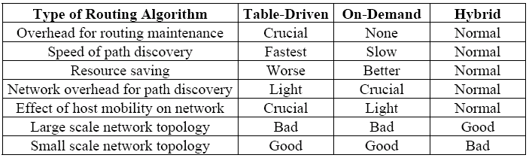
Performance evaluation of routing algorithms.

Slide 10
GPS-QHRA
Zone Map Design
Determination of the LDN
Generating Routing Tables
Routing Rule
Location Update Rule
Rule for Re-Determining the LDN

Slide 11
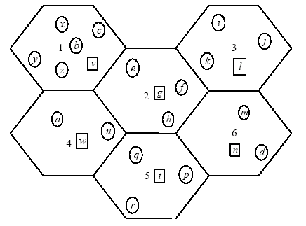
Zone Map Design

Slide 12
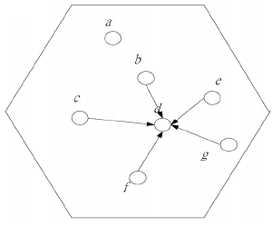
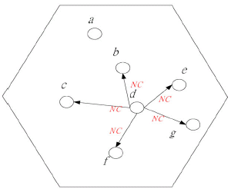
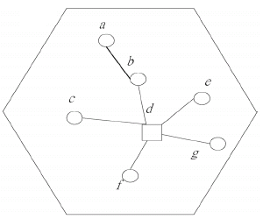
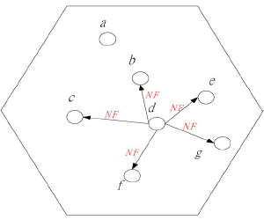
Determination of the LDN

Slide 13
Routing Rule
Source and Destination are in the same zone:
  Table-Driven routing algorithm is used.
  Data forwarded along the route given in the database node’s routing table.
Source and destination are in distinct zones:
  On-Demand routing algorithm is applied.
  the packet is routed to the destination via the database
  node of the destination and completes the forwarding process by referencing the routing table.

Slide 14
Location Update Rule
Regular update: A LDN will periodically examine other nodes within its zone and corresponding routes, and periodically inform about the zone’s residents.
Update on transmission: If data forwarding is requested and the GPS determines that a node has left its original zone, then the node must register to its new LDN. The new zone’s LDN will update its routing table with routing information corrresponding to this new member.

Slide 15
Re-Determining the LDN
The re-determination mechanism is automatically initiated when the LDN moves into the danger zone.
The newly selected database location node then informs the old LDNs of UQS.
The intra-zone routing must be recalculated, and the information is then multicast to other members of UQS.

